Slide 1
Are Reasoning Capabilities
Present in Base Models?
Wufei, Aidan, Kaavya, Mohammad, Elisabeth

Slide 2
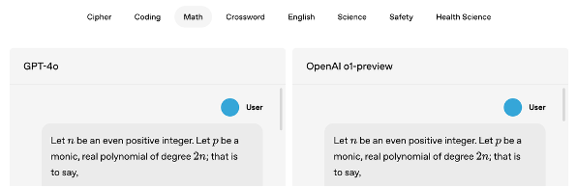
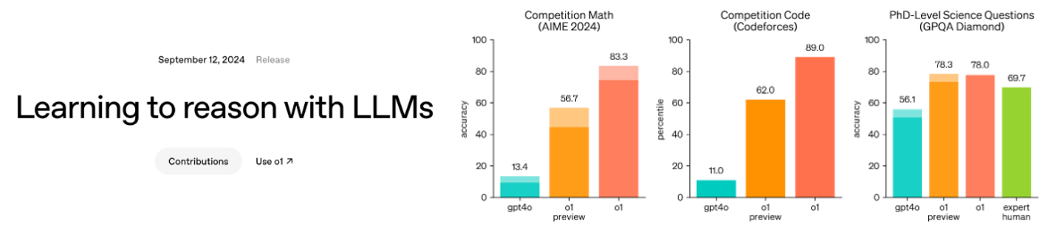
“Reasoning” Models
More complex reasoning problems
Power of reasoning models

Slide 3
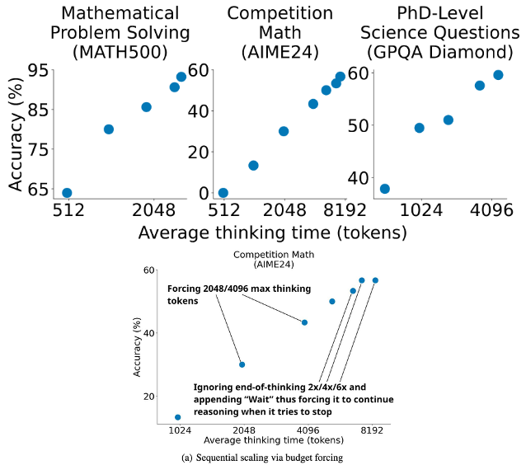
Test-Time Scaling
1,000 reasoning samples for SFT training
“Budget forcing” for test-time scaling.
“Wait,” and “Final answer:”

Slide 4
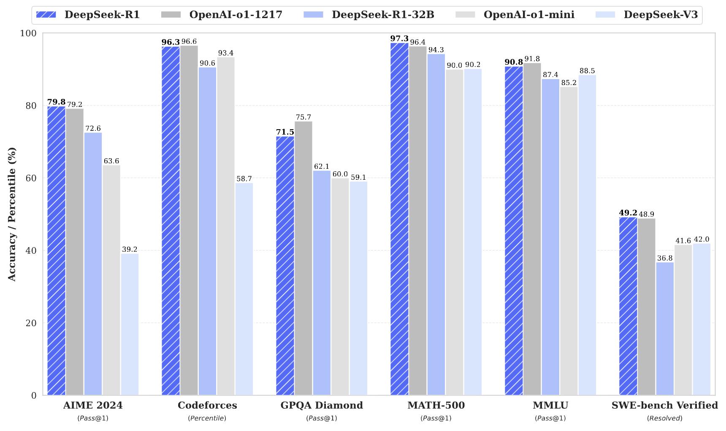
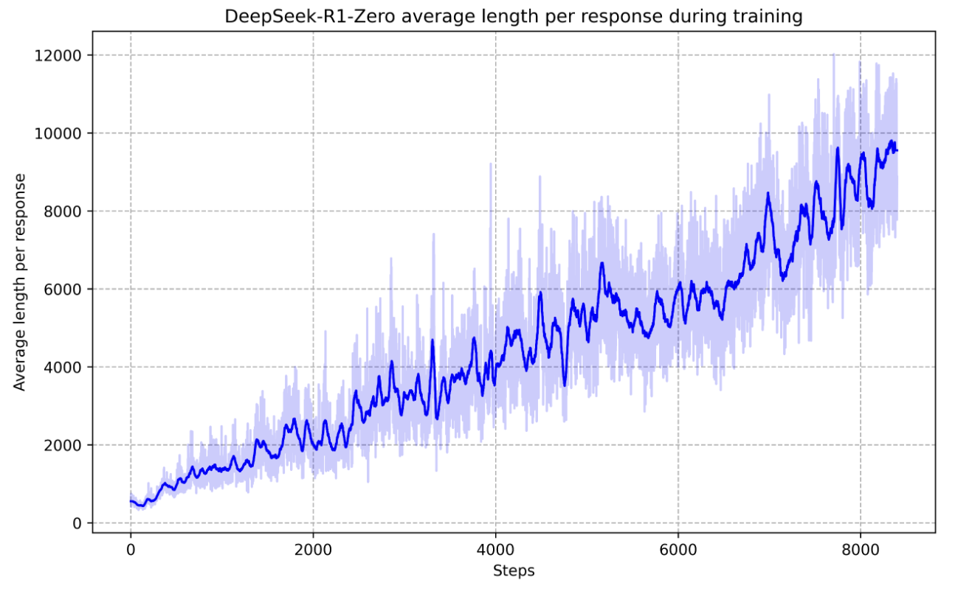
GRPO
An RL recipe that achieves o1-like performance
GRPO-trained model more often exhibit:
Increasing response length
Self-reflection

Slide 5
Rethinking RL
What is the difference between base and thinking models that allows the latter to achieve superior performance?
Are the capabilities emerged from RL fundamentally novel behaviors not in the base model?

Slide 6
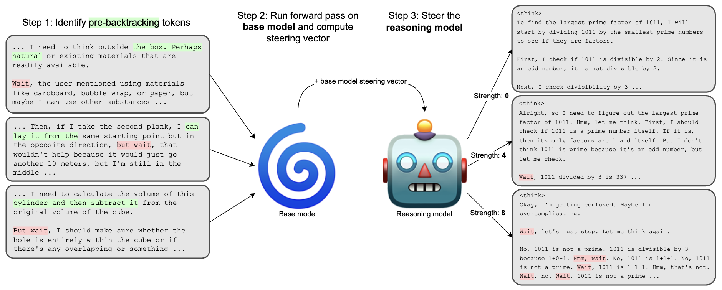
Hypotheses
Entirely new reasoning abilities acquired during RL.
Repurposing pre-existing representations for new mechanisms.
A “steering vector” that unlocks backtracking.

Slide 7
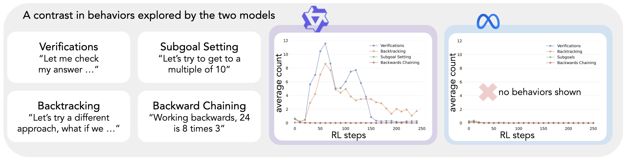
Hypotheses
Entirely new reasoning abilities acquired during RL.
Repurposing pre-existing representations for new mechanisms.
Reasoning abilities in base model.
Behaviors of verification, subgoal setting, backtracking, backward chaining…

Slide 8
Hypotheses
Entirely new reasoning abilities acquired during RL.
Repurposing pre-existing representations for new mechanisms.
Reasoning abilities in base model.
Amplifying effective reasoning patterns before RL.

Slide 9
Hypotheses
Entirely new reasoning abilities acquired during RL.
Repurposing pre-existing representations for new mechanisms.
Reasoning abilities in base model.
Amplifying effective reasoning patterns before RL.
If base models already have the knowledge necessary for reasoning, we can skip time-intensive RL/ SFT and use training-free methods to elicit desired behavior from base models.

Slide 10
Outline
Paper 1: Base Models Know How to Reason, Thinking Models Learn When
Paper 2: Reasoning with Sampling: Your Base Model is Smarter Than You Think
Base models already possess reasoning capabilities

Slide 11
Base Models Know How to Reason, Thinking Models Learn When

Slide 12
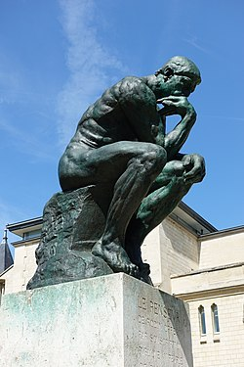
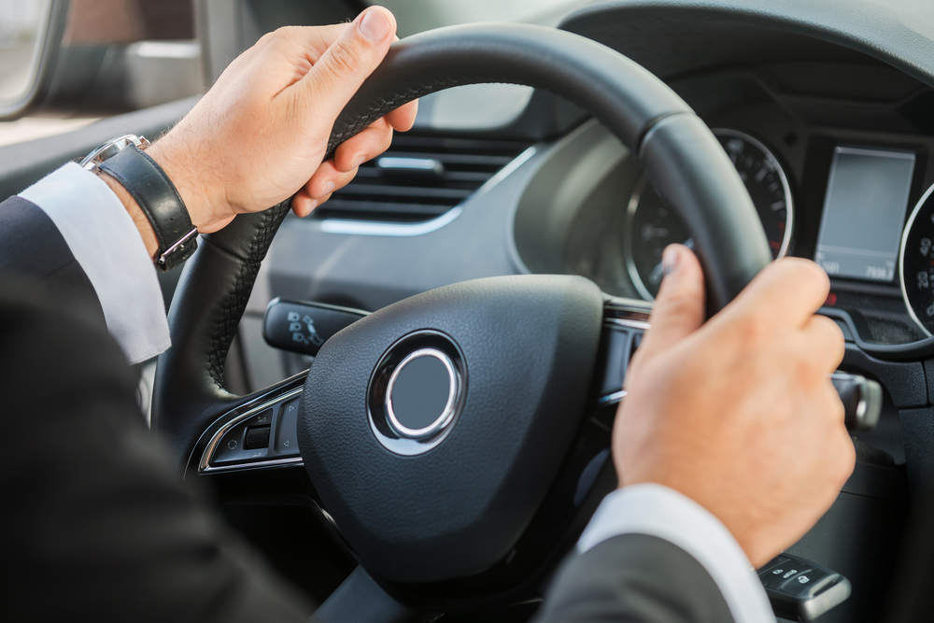
Premise / Summary
What “types” of reasoning do (SFT) LLMs use?
Empirical view: 10-20 types (?)
Are these types present in base models?
Knowing “when” to reason is in activations
How do we prove the above?
Using SFT models to “steer” base models

Slide 13
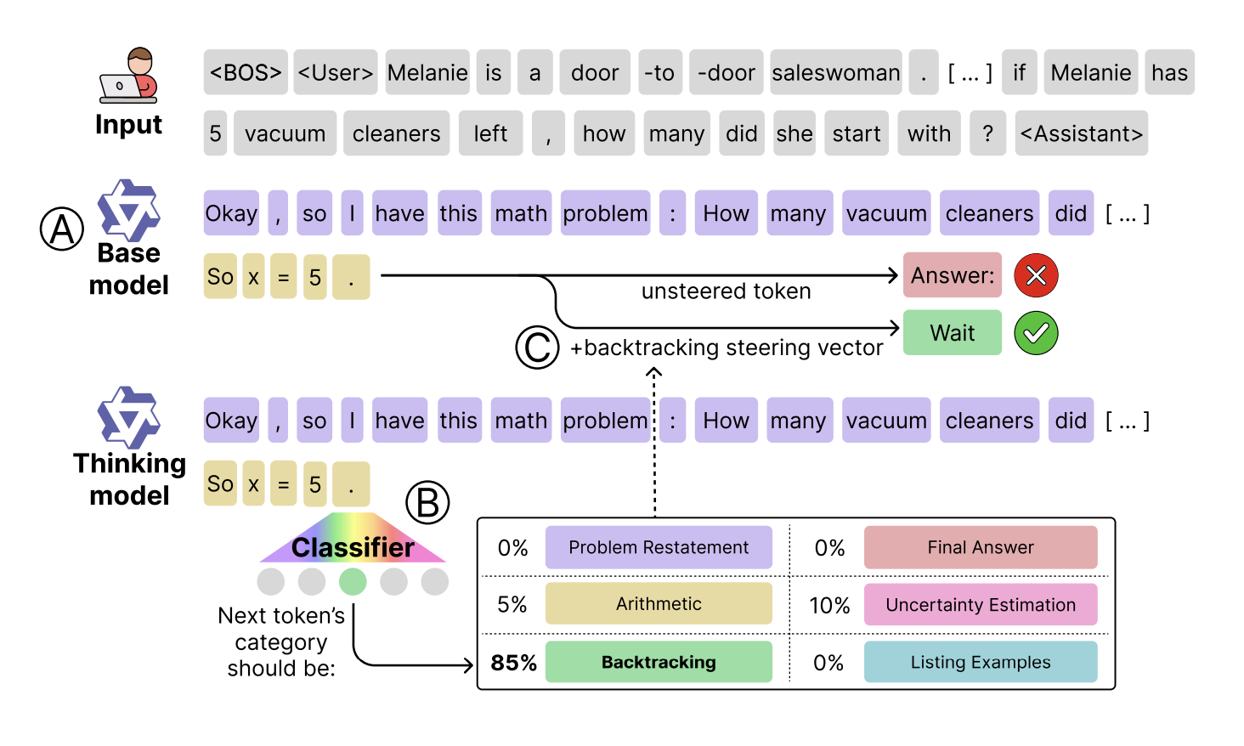

Slide 14
Taxonomy Curation
A taxonomy of reasoning methods must be:
Interpretable
Each reasoning method should be understandable to humans
Complete
Cover all of the possible reasoning methods
Independent (aka disjoint)
No overlap between methods

Slide 15
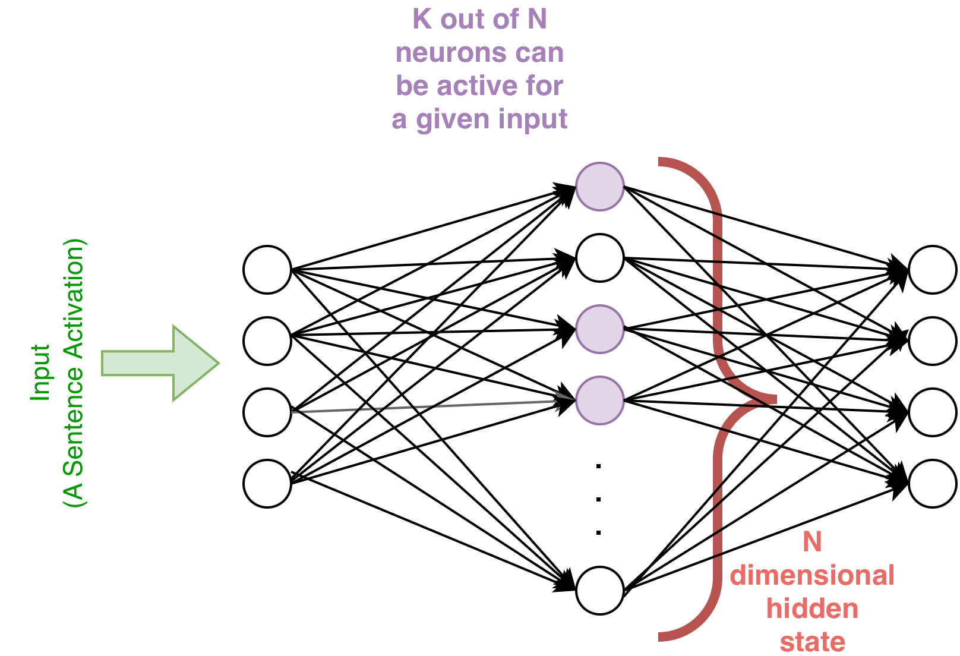
Taxonomy Curation via Sparse Autoencoders
Autoencoders enable efficient latent representations

Slide 16
Taxonomy Curation via Sparse Autoencoders
Gpt o4-mini analyzes the sentences in each “cluster”
Extracts cluster title and description
“It should also be noted that…”
“Another key element to keep in mind is …
Activated Neuron
“Crucial to this argument is also the fact that .. “
Cluster title:
Additional Considerations

Slide 17
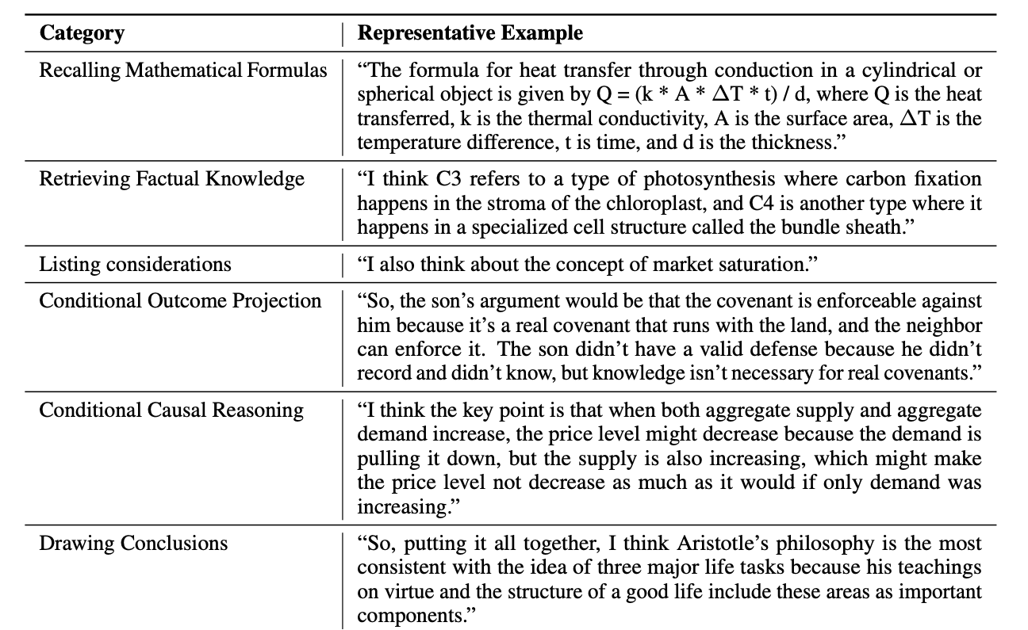
Examples of Identified Reasoning Strategies

Slide 18
Finding a Steering Vector
For each reasoning strategy in the taxonomy of reasoning strategies:
Identify the sentences from the reasoning model which employ that reasoning strategy (reasoning sentence)
“Therefore, the old policy must be immediately reinstated." (Strategy: Drawing Conclusions)
Extract the tokens that lead up to each reasoning sentence in each respective reasoning trace (preceding tokens)
Ex. "Crime rose 15% following the policy change."
Optimize a steering vector in the base model to minimize cross entropy on the reasoning sentence given the preceding tokens

Slide 19
Generation with the hybrid model
During generation:
Use SAE to identify most active reasoning category at each token position in the base model’s generated tokens
Apply the steering vector for the strongest reasoning category to the base model activations
The hybrid model is the base model guided with steering vectors derived from the reasoning model

Slide 20
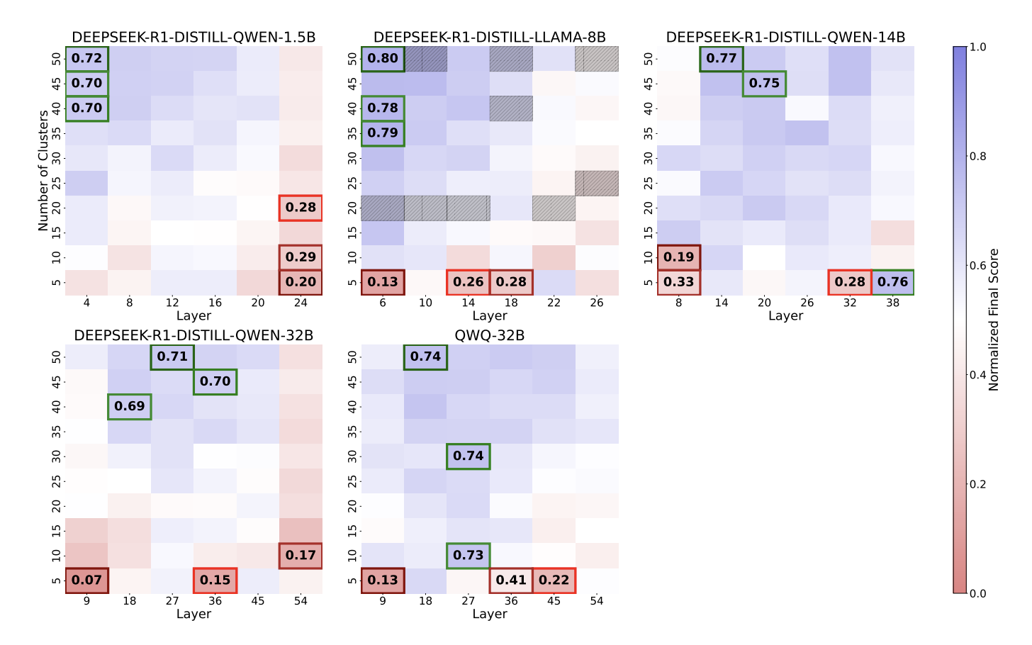

Slide 22
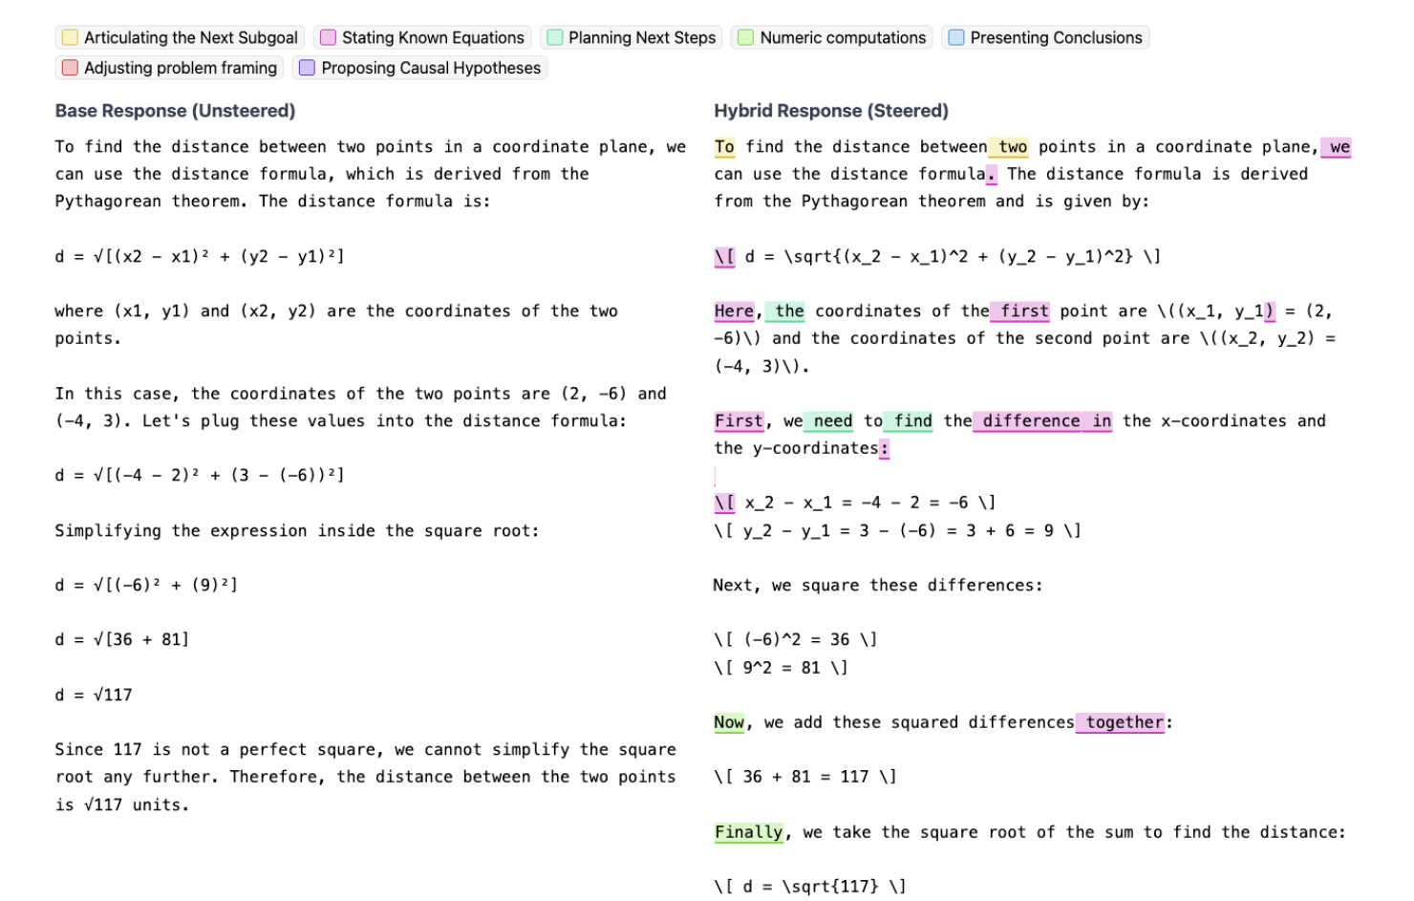

Slide 23
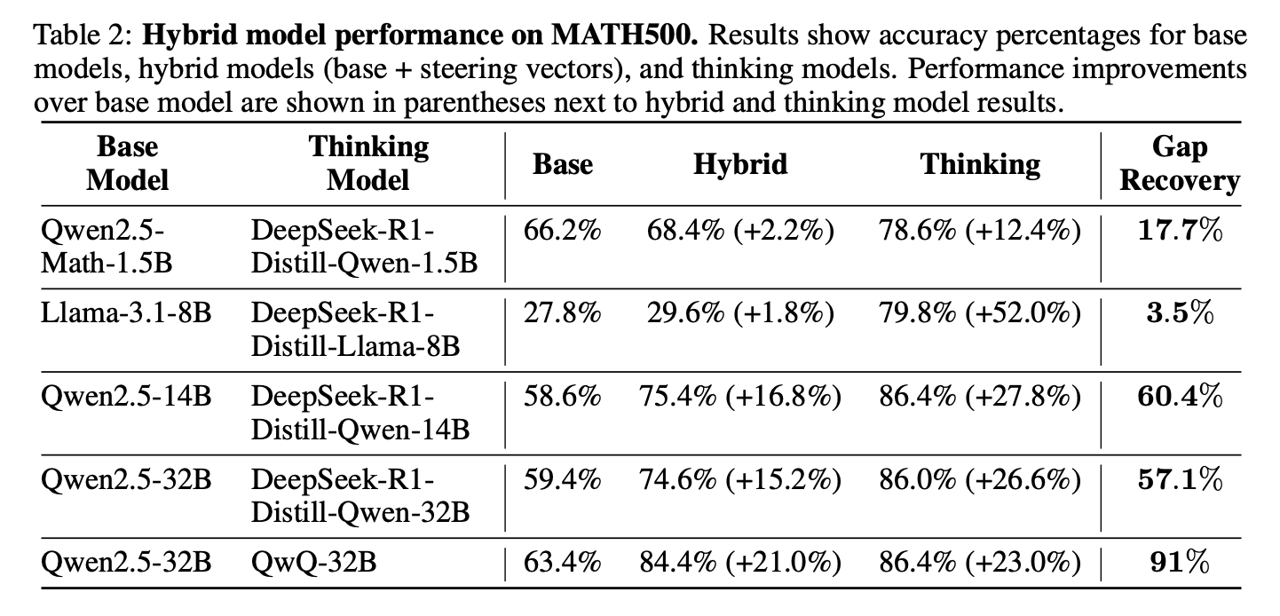

Slide 24
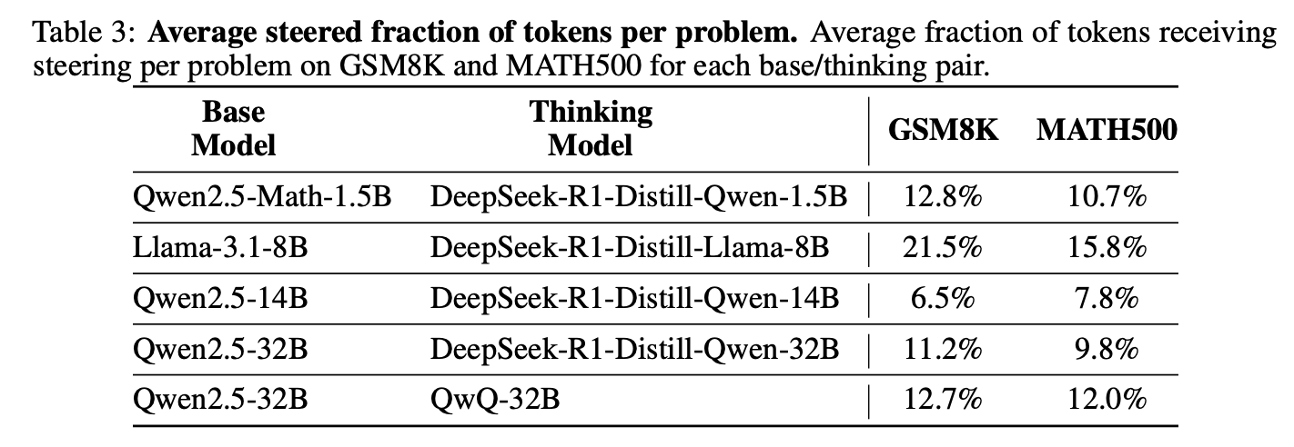

Slide 25
Paper Summary
Presents a taxonomy of reasoning behaviors that thinking (also known as reasoning) models exhibit when doing chain of thought
Using the taxonomy, derives ‘steering vectors’ for each reasoning method
Demonstrates that a hybrid approach of base model + steering vectors allows the base model perform every reasoning method that a reasoning model employs

Slide 26
Reasoning with Sampling: Your Base Model is Smarter Than You Think

Slide 27
Hypotheses
Entirely new reasoning abilities are acquired after RL.
Repurposing pre-existing representations for new mechanisms.
“Amplifying” behaviors learned in pretraining.
If base models already have the knowledge necessary for reasoning, we can skip time-intensive RL/ SFT and use training-free methods to elicit desired behavior from base models.

Slide 28
Intuition
RL’d models are much better at reasoning tasks than base models. But why?
Prior work, empirical observation→ p_{RL}(x) looks like base p(x) but “sharpened”
If so, is there any other way to “sharpen” and “sample” from the distribution?
Authors present that sampling directly from the sharpened base model can achieve single-shot reasoning capabilities on par with those from RL
They propose sampling algorithm is training-free, dataset-free, and verifier-free

Slide 29
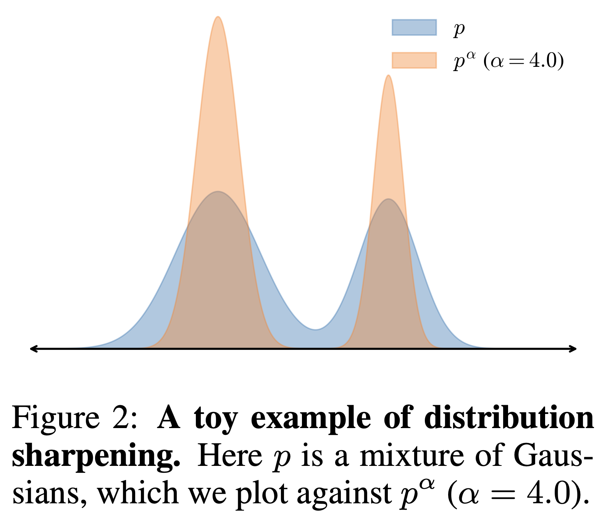
Sharpening with Power Distributions
Simply means re-weighting the distribution
So that high likelihood sequences are further upweighted
While low likelihood ones are downweighted
→ Bias the samples heavily towards higher likelihoods

Slide 30
Sharpening with Power Distributions
Example: For a given prompt, let base probabilities over possible sequences be:
𝑝(𝑥⁽¹⁾) = 0.50 → For the 1st possible sequence 𝑝(𝑥⁽²⁾) = 0.30 → 2nd 𝑝(𝑥⁽³⁾) = 0.20 → 3rd
Let’s pick 𝛼 = 2:
𝑝_{𝛼}(𝑥⁽¹⁾) ∝ 0.50² = 0.25 , 𝑝_{𝛼}(𝑥⁽²⁾) ∝ 0.30² = 0.09, 𝑝_{𝛼}(𝑥⁽³⁾) ∝ 0.20² = 0.04
Sum = 0.38 → normalizing:
𝑝_{𝛼}(𝑥⁽¹⁾) = 0.66, 𝑝_{𝛼}(𝑥⁽²⁾) = 0.24, 𝑝_{𝛼}(𝑥⁽³⁾) = 0.10

Slide 31
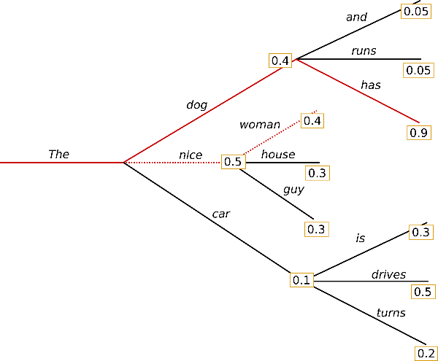
Temp. Sampling vs Power Distribution
Base
Temp
Pow.
.00
.02
.00
.00
.29
.00
.02
.00
.00
.61
.99
.36
.29
.87
.71
.19
.20
.43
.08
.15
.14
.02
.19
.11
.15
.14
.02
.00
.03
.00
.00
.87
.05
.00
.00
.02
.02
.00
.00

Slide 32
Why is this non-trivial?
There are exponentially many possible sequences 𝑥
We cannot enumerate them all or normalize 𝑝(𝑥)^{𝛼}
However, we can compute 𝑝(𝑥)^{𝛼} for any given completed answer 𝑥
Still, we don’t know the normalization constant or the whole space
Enter Metropolis-Hastings (MH) - a Markov Chain Monte Carlo (MCMC) algorithm

Slide 33
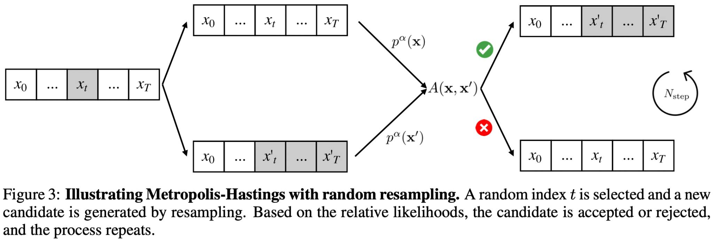
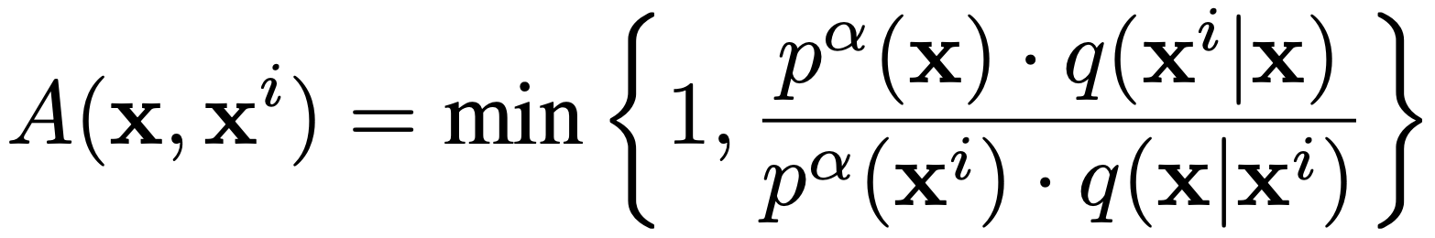
The Metropolis-Hastings (MH) Algorithm

Slide 34
The Metropolis-Hastings (MH) Algorithm
Sample from a distribution proportional to 𝑝(𝑥)^{𝛼} instead of exactly 𝑝(𝑥)^{𝛼} using only ratios of the probabilities of candidate and current sequences, so the normalization constant cancels out
Start at some sequence 𝑥⁽⁰⁾
Select a random index t in 𝑥⁽⁰⁾, propose a new candidate sequence 𝑥′ produced by generating rest of 𝑥⁽⁰⁾ using some proposal distribution 𝑞(𝑥′ | 𝑥^{(𝑖)})
Compute the acceptance probability
Draw u ∼ Uniform(0, 1)
If u <= A(x, x^{(𝑖)}), accept and set 𝑥^{(𝑖+1)} = 𝑥′
Otherwise reject and set 𝑥^{(𝑖+1)} = 𝑥^{(𝑖)}t
If repeated many times, the state of the chain (current full answer), will in the long run be distributed according to our target distribution proportional to 𝑝(𝑥)^{𝛼}

Slide 35
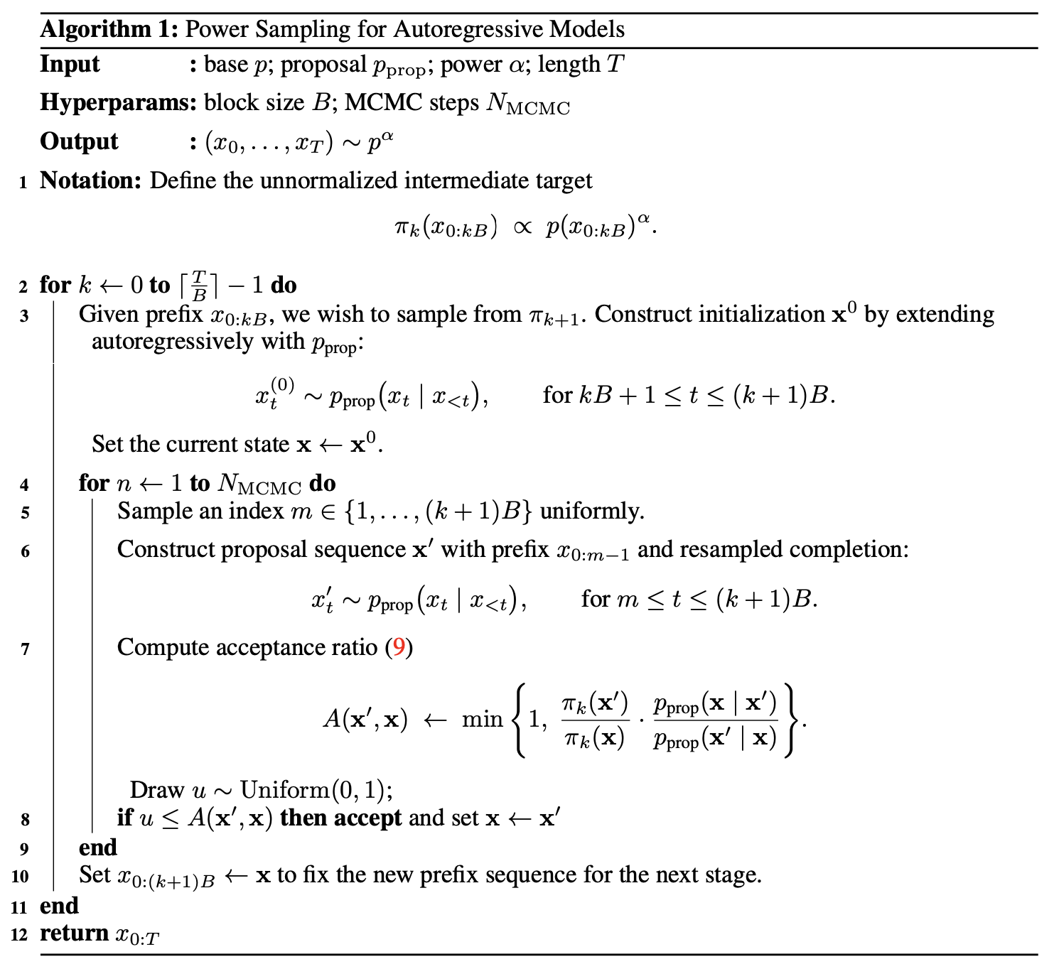
Autoregressive MCMC

Slide 36
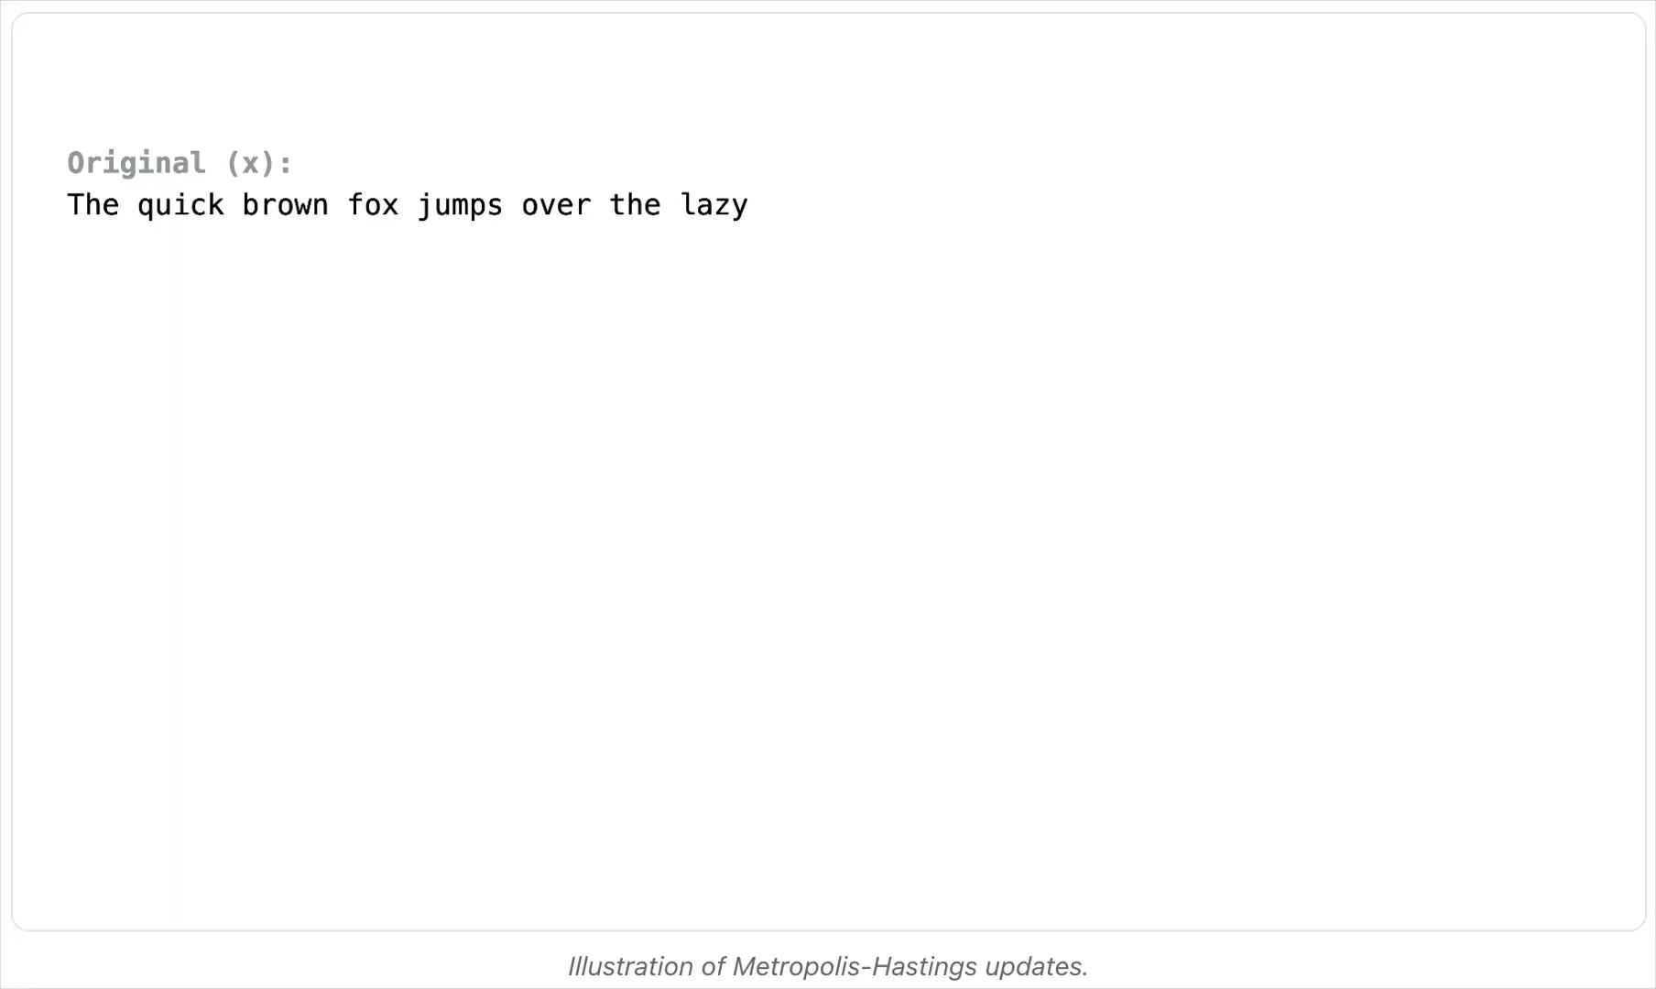

Slide 37
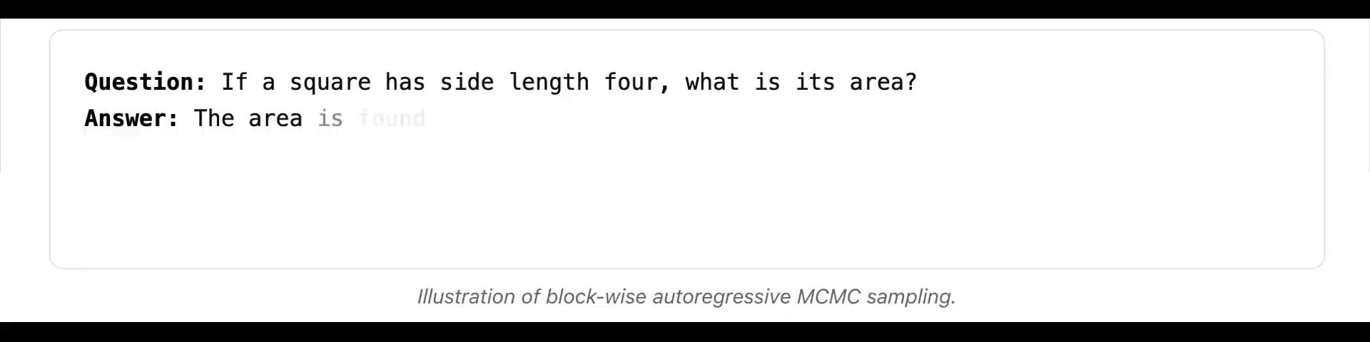

Slide 38
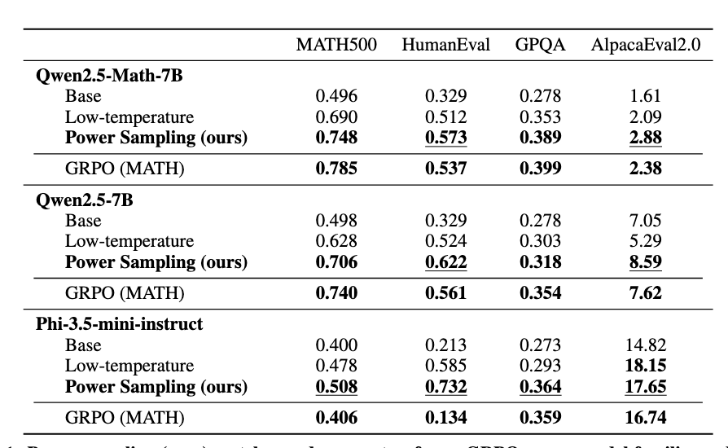
Results
Outperforms GRPO on the Phi model
Better results on out of domain tasks
Except GPQA

Slide 39
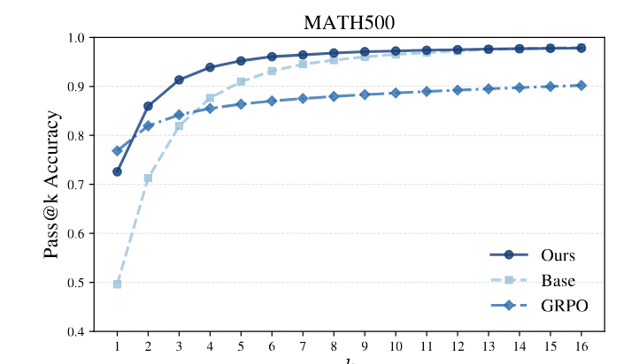
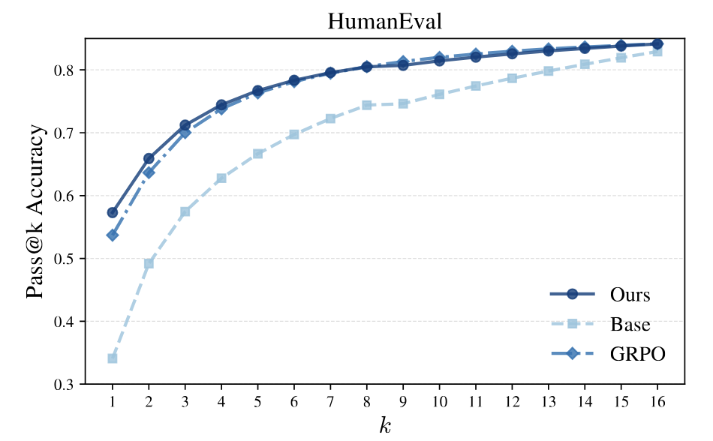
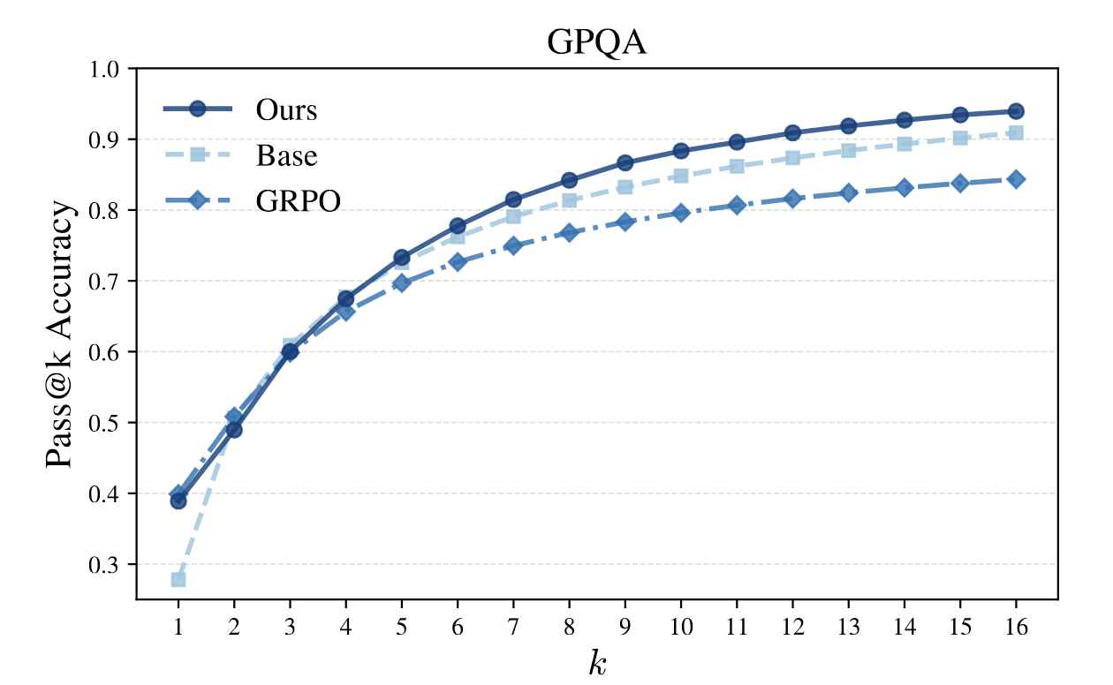
Pass @ k

Slide 40
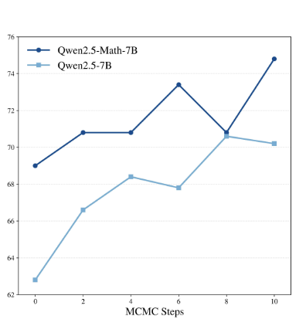
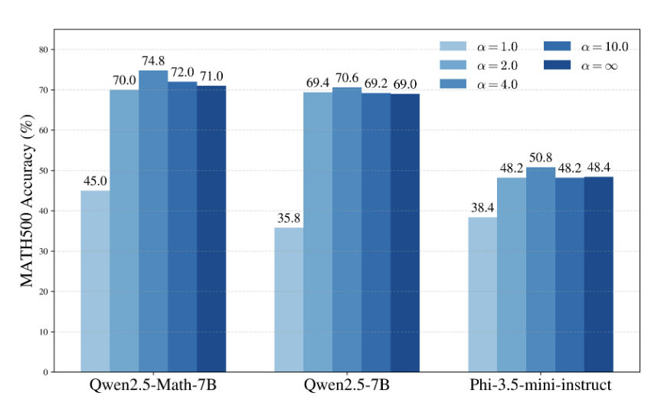
Computational cost
Average output length:
Base: 600
GRPO: 671
Sampling: 679
Sampling generates 8.84x #tokens compared to the base model.
correction : 11.34x
Leading to comparable inference costs as one epoch of GRPO (8-16 rollouts)

Slide 41
Discussion Questions
Should we still care about RL and SFT?
Is there any reason to believe that reasoning models do things that base models will never be able to?
What counts as “learning to reason”?
If RL simply ‘drives’ or ‘reweights’ existing behaviors, is that qualitatively different from how humans learn to reason?

Slide 42
Thank you!

